Slide 1
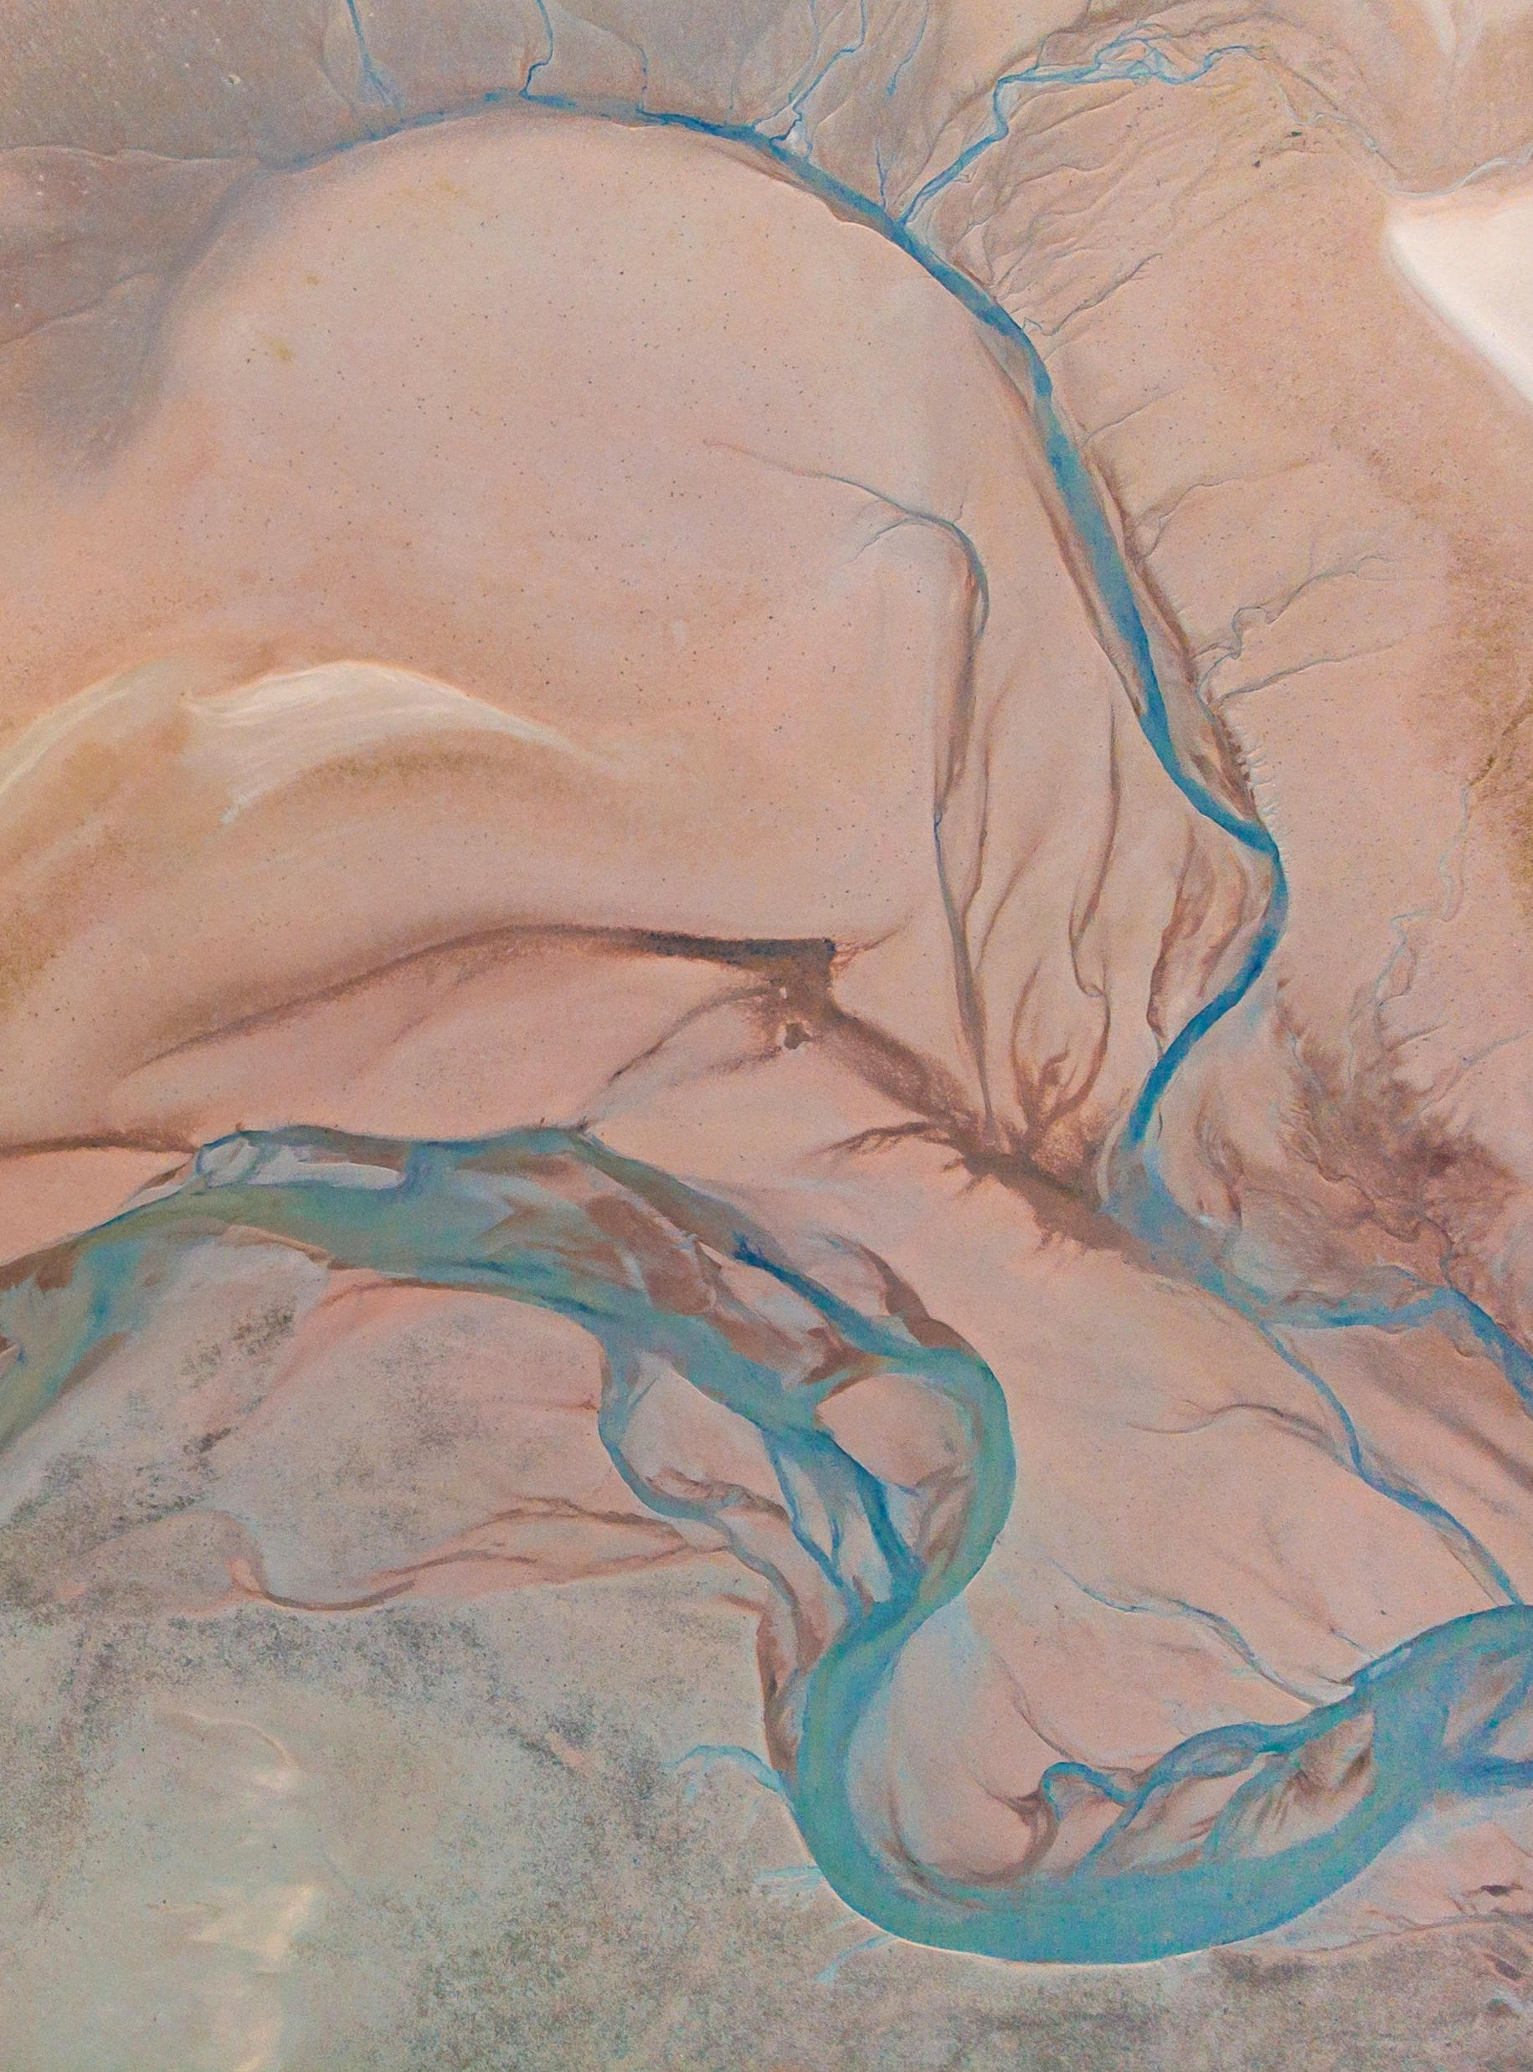
Automatic control project
Presentation subtitle

Slide 2
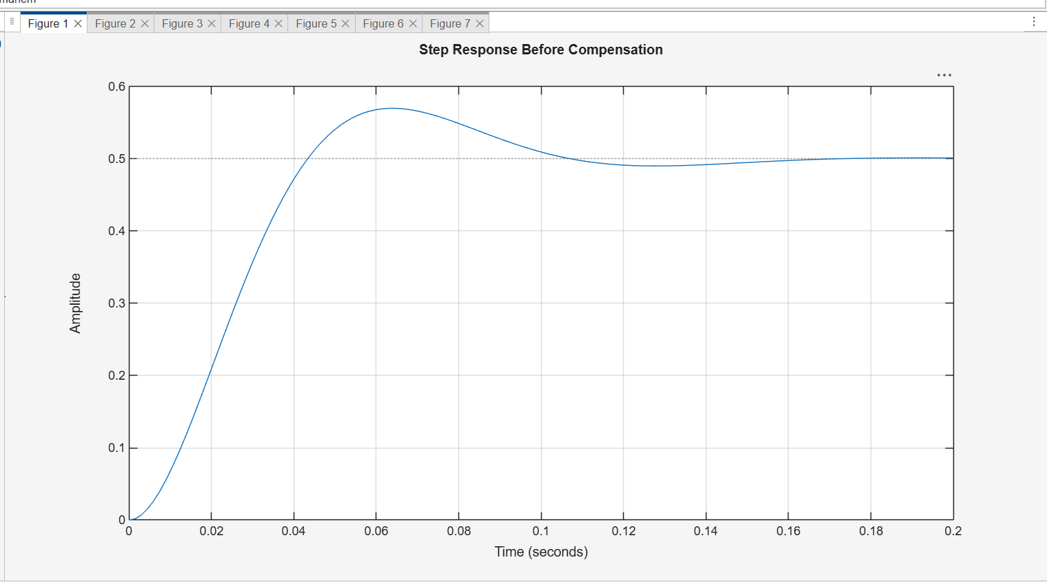

This figure shows the step response of the system before adding the compensator.
The response reaches a final value of approximately 0.5.
The system has an overshoot of about 14%, and the settling time is 0.0997 sec.

Slide 3
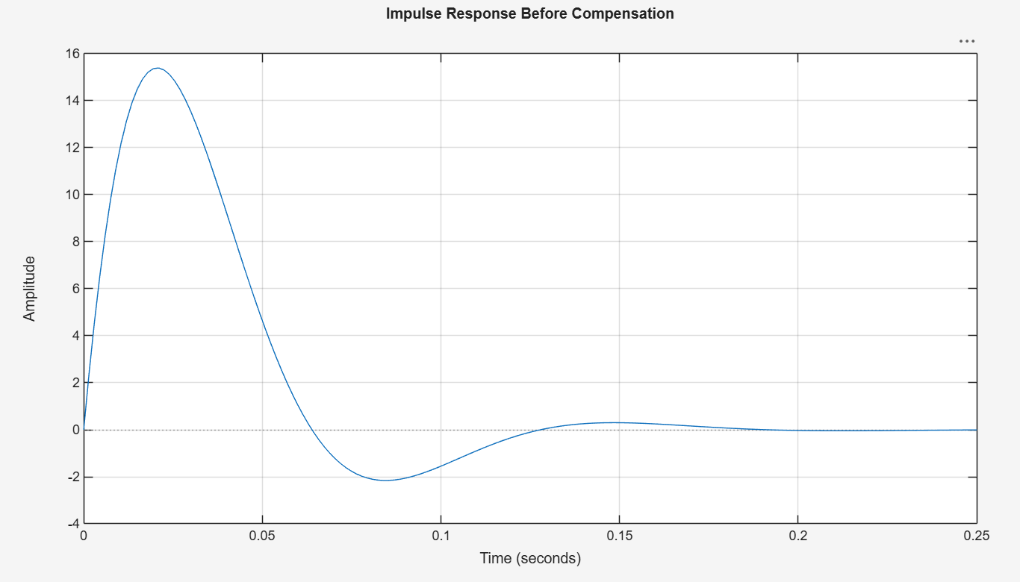
This figure shows the impulse response before compensation.
The response rises quickly, then oscillates and gradually decays to zero.
This means the system is stable because the response does not grow with time.

Slide 4
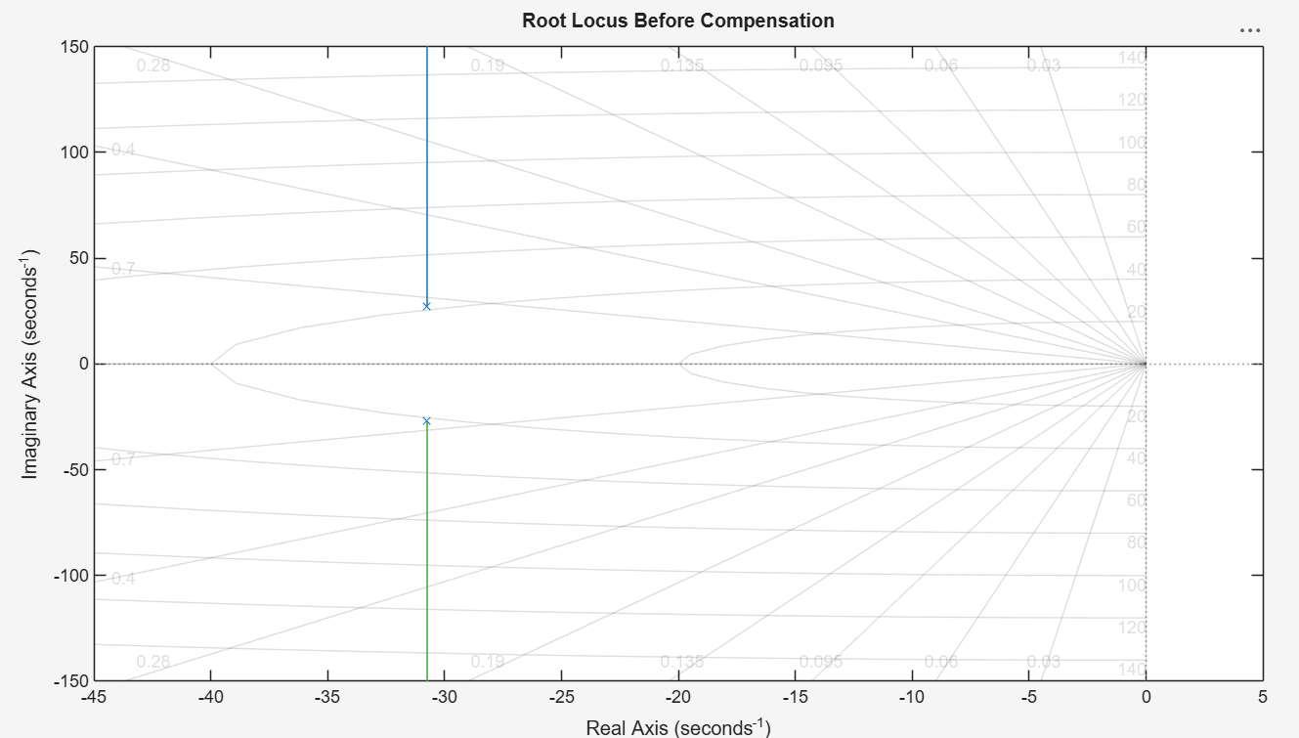
This figure shows the root locus of the uncompensated open-loop system.
The root locus is used to study how the closed-loop poles move when the gain changes.
The system poles are located in the left half of the s-plane, so the system is stable.

Slide 5
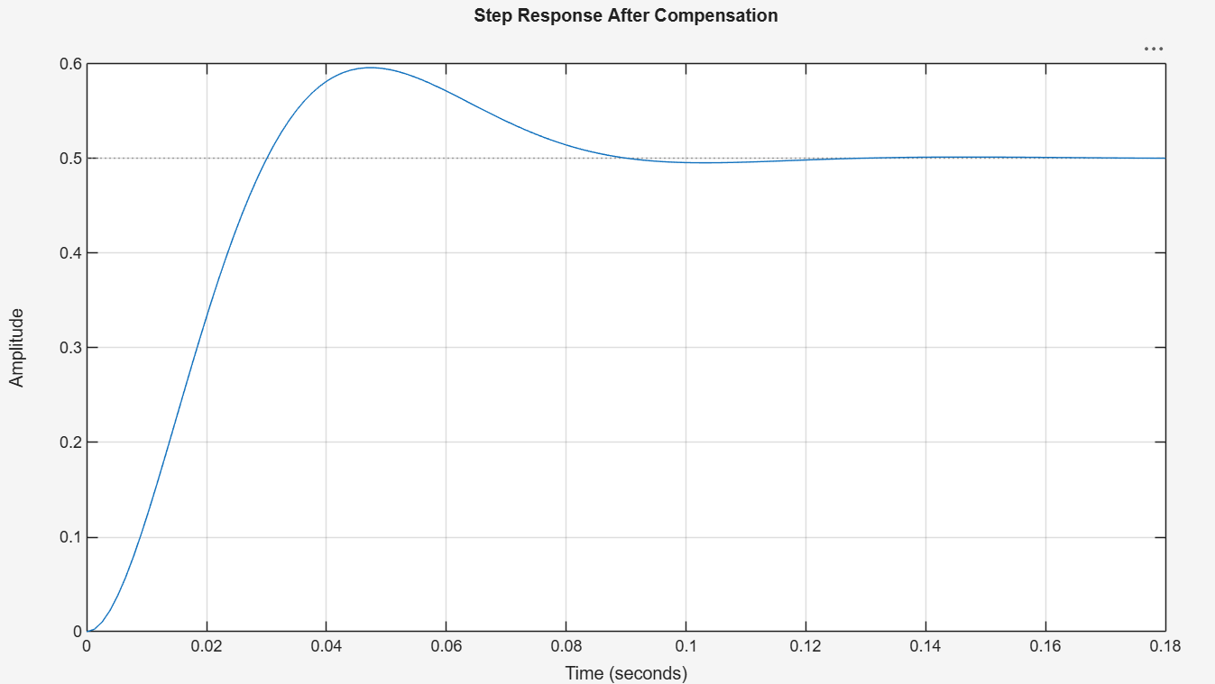
Thi figure shows the step response after inserting the compensator.
Thse response becomes faster than before compensation.
The overshoot becomes approximately 19.2%, which is close to the required 20%.
The settling time becomes 0.0824 sec, which is less than 2 sec.

Slide 6
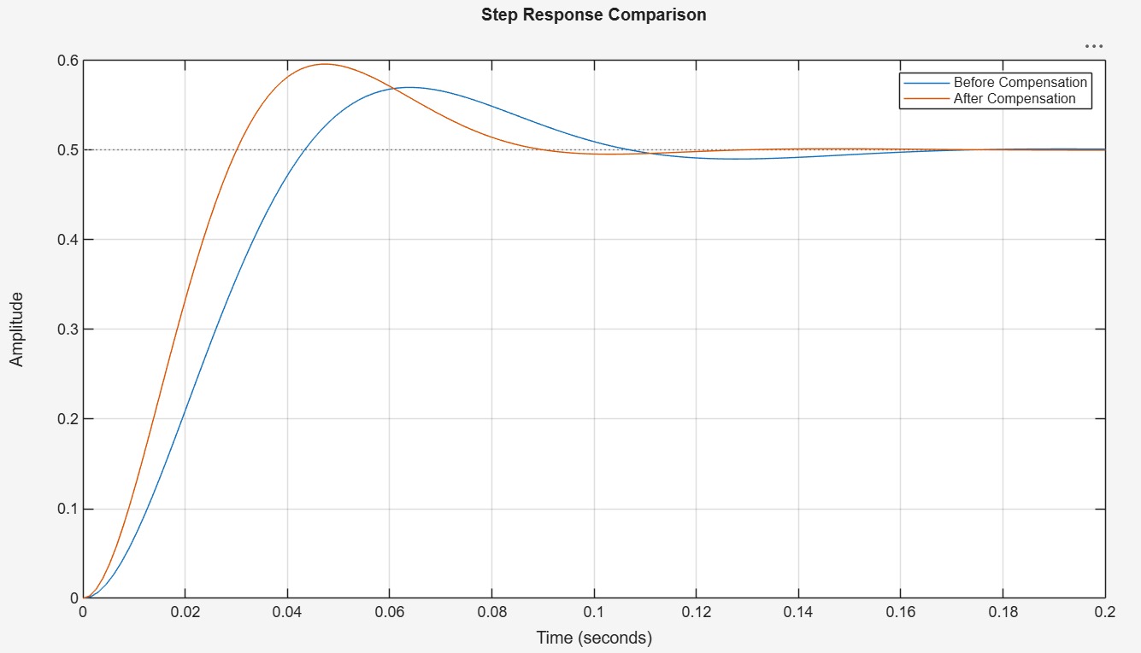
This figure compares the step response before and after compensation.
The compensated system reaches the steady state faster.
The rise time and settling time are improved.
Also, the overshoot is increased from 14% to approximately 19.2%

Slide 7
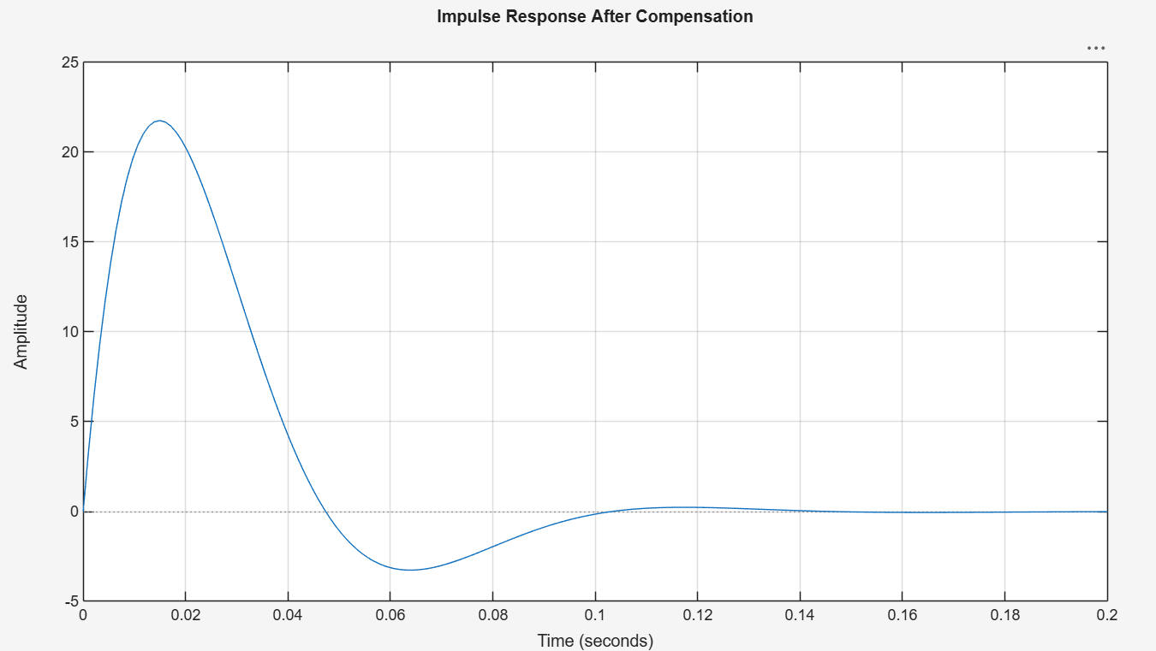
This figure shows the impulse response after compensation.
The response still decays to zero, which means the compensated system remains stable.
The response is faster compared with the uncompensated system.

Slide 8
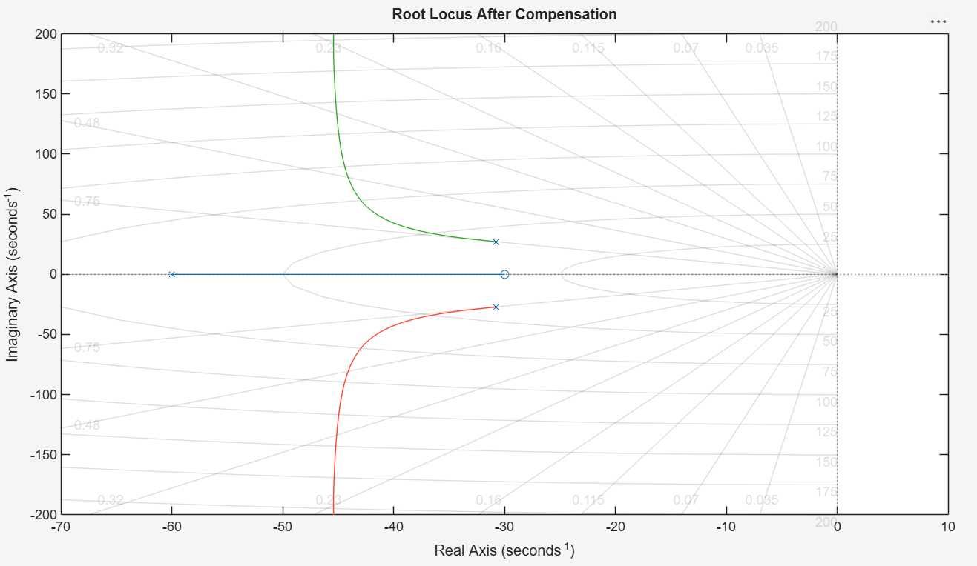
This figure shows the root locus after adding the compensator.
The compensator changes the root locus by adding a zero and a pole to the open-loop transfer function.
The closed-loop poles remain in the left half-plane, so the compensated system is stable.

Slide 9
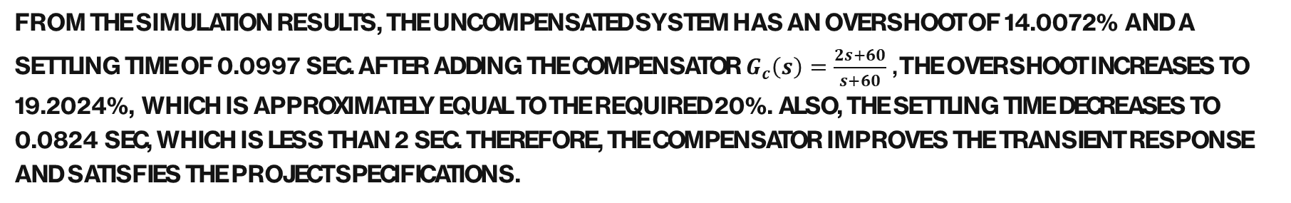
System Performance Comparison
Parameter | Before Compensation | After Compensation
Rise Time | 0.0293 sec | 0.0205 sec
Settling Time | 0.0997 sec | 0.0824 sec
Overshoot | 14.0072% | 19.2024%
Peak Time | 0.0644 sec | 0.0480 sec
Peak | 0.5700 | 0.5960
From the simulation results, the uncompensated system has an overshoot of 14.0072% and a settling time of 0.0997 sec. After adding the compensator $G_{c}\left(s\right)=\frac{2s+60}{s+60}$, the overshoot increases to 19.2024%, which is approximately equal to the required 20%. Also, the settling time decreases to 0.0824 sec, which is less than 2 sec. Therefore, the compensator improves the transient response and satisfies the project specifications.

